Slide 1
Simple Pick And place Robot
Simple Robots using arduino

Slide 2
Aim: Domestic Pick and Place robot.
Hardware:
Pick and place robot kit, Arduino UNO, L293D, Batteries, PS2 controller, wire.
Software:
OS-Windows/Mac/Linux, Arduino IDE.

Slide 3
Arduino
Arduino is an open-source electronics platform based on easy-to-use hardware and software.
Arduino boards are able to read inputs - light on a sensor, a finger on a button, or a Twitter message - and turn it into an output - activating a motor, turning on an LED, publishing something online.
You can tell your board what to do by sending a set of instructions to the microcontroller on the board.

Slide 4
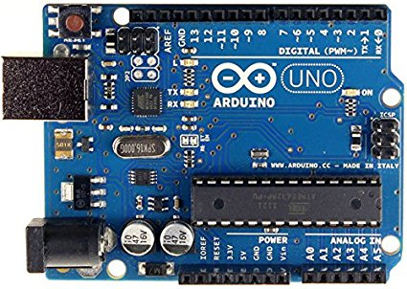
Pins on arduino
There are 14 digital Pins and 6 Analog Pins on Arduino UNO Board.

Slide 5
How to connect motor to arduino?
Arduino Boards cannot do much on their own. They need different sensors and actuators to interact with surrounding.
Arduino is a ecosystem which also develop stuff which is required by arduino boards.
Consider, motor for instance a typical 9V DC Motor requires about 1A of current.
But, Arduino boards operate at 5V and can at max provide 400mA. The amount of power motors need would literally fry the board.
Here motor drivers come into picture. They hand the Voltage and current for Arduino.

Slide 6
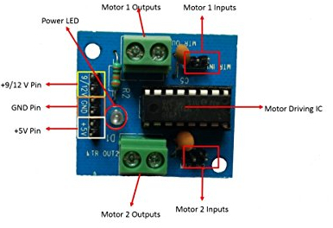
MOtor Driver
Motor Driver is used to attach motors to arduino.
It handles the high voltage and current part, so Arduino board does not need to deal with it.
Most commonly used and simple to used motor driver is L293D.
It works on principle of H-bridge.

Slide 7
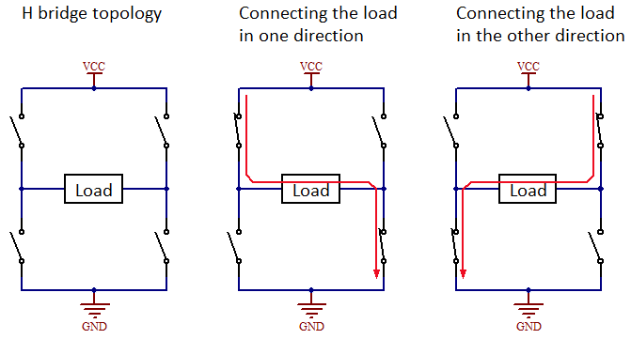
H-Bridge of transistors

Slide 8
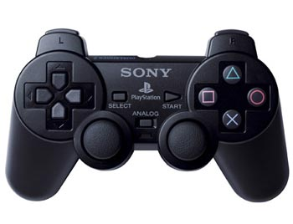
PS2 Controller
Sony PlayStation 2 Dualshock Controller is a good option as a controller.
It is reliable.
It has been part of Arduino Ecosystem since Arduino exist.
It has stable and reliable library to connect it to Arduino.

Slide 9
Thank you

